Slide 1
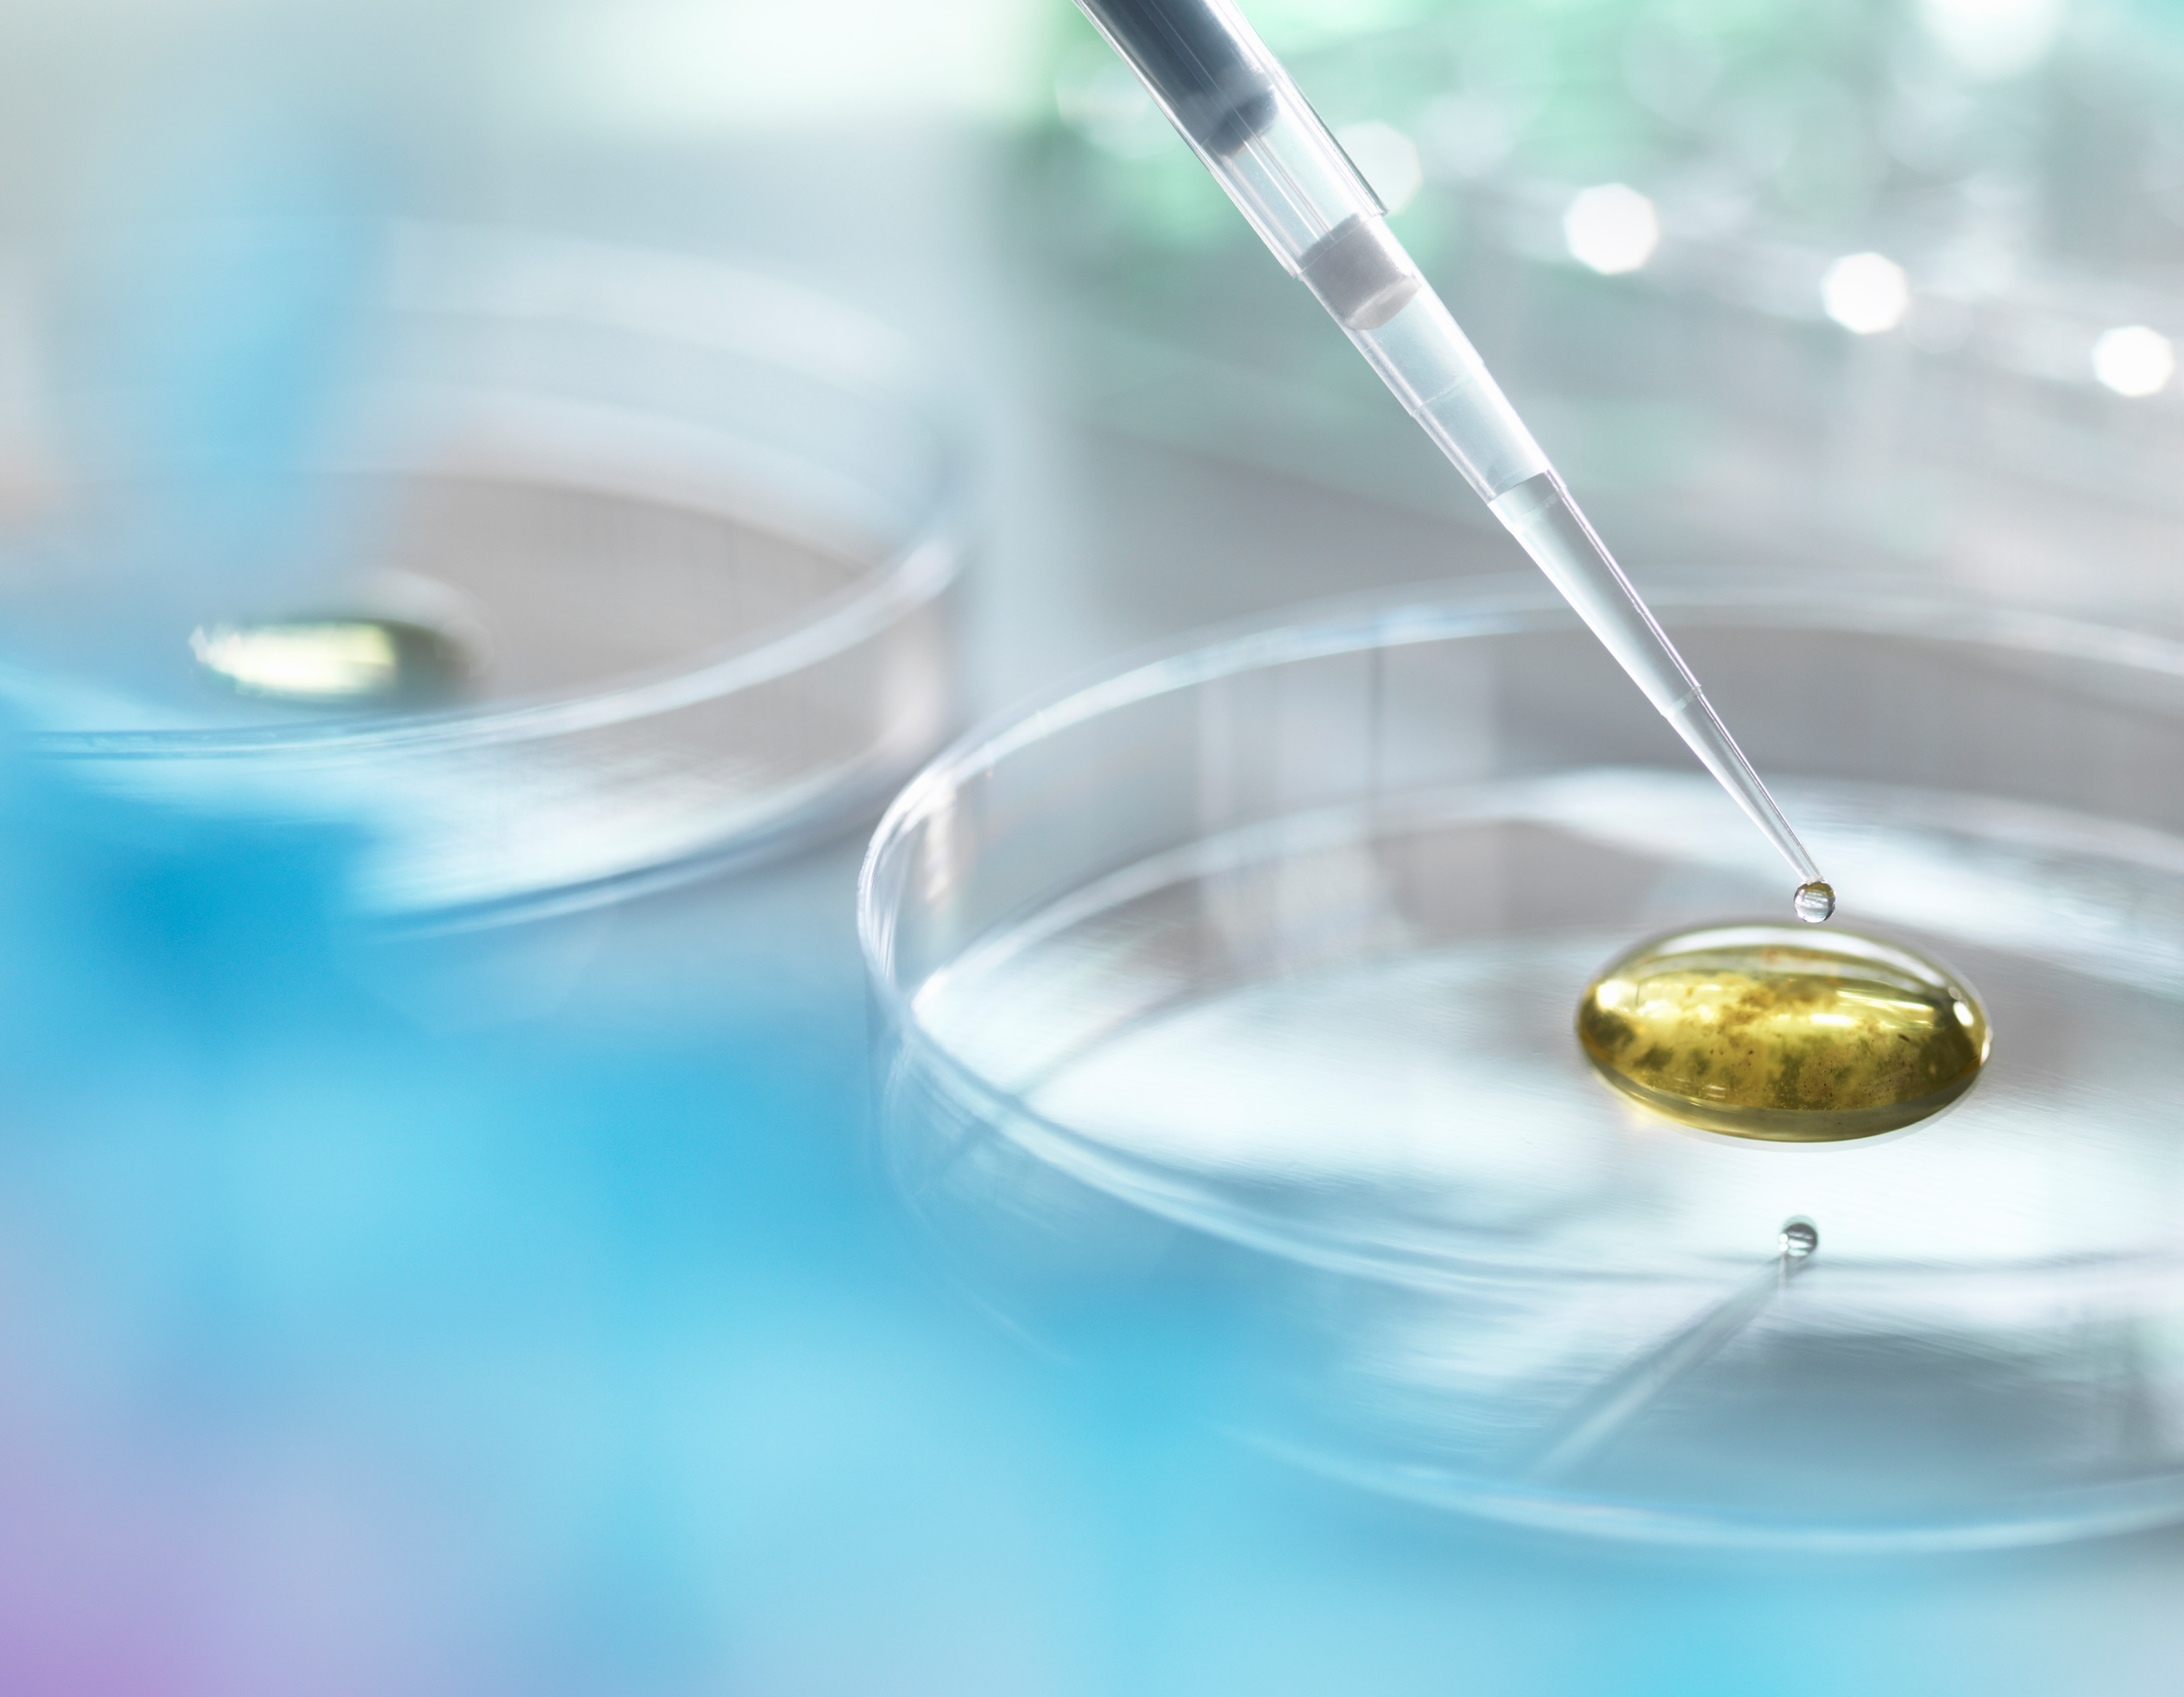
Mini project: Metallurgical microscope : working principle and operation
By group:
Anurag, Balaji, Neeraj Dattu, Anusha , Sandeep, harikrishna , Praveen, Jayanth , jaswanth

Slide 2
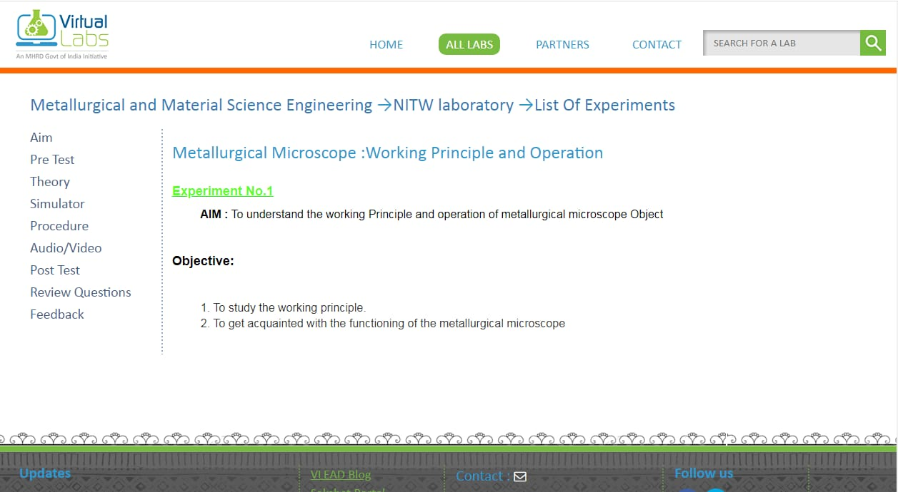
Pictures of our webpage : a glance

Slide 3
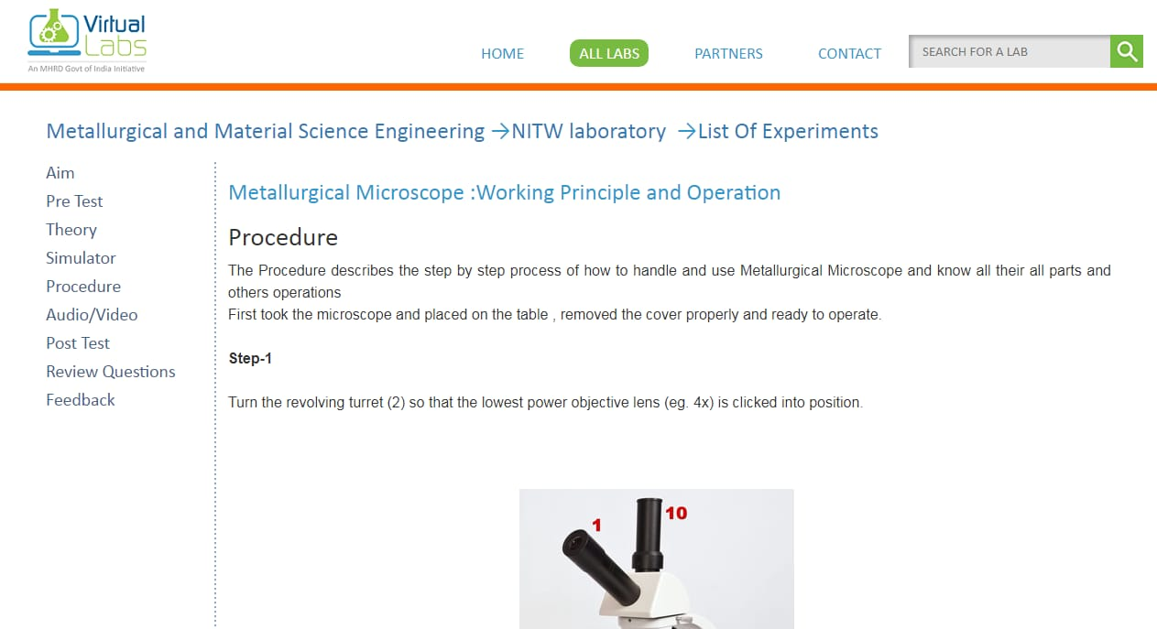

Slide 4
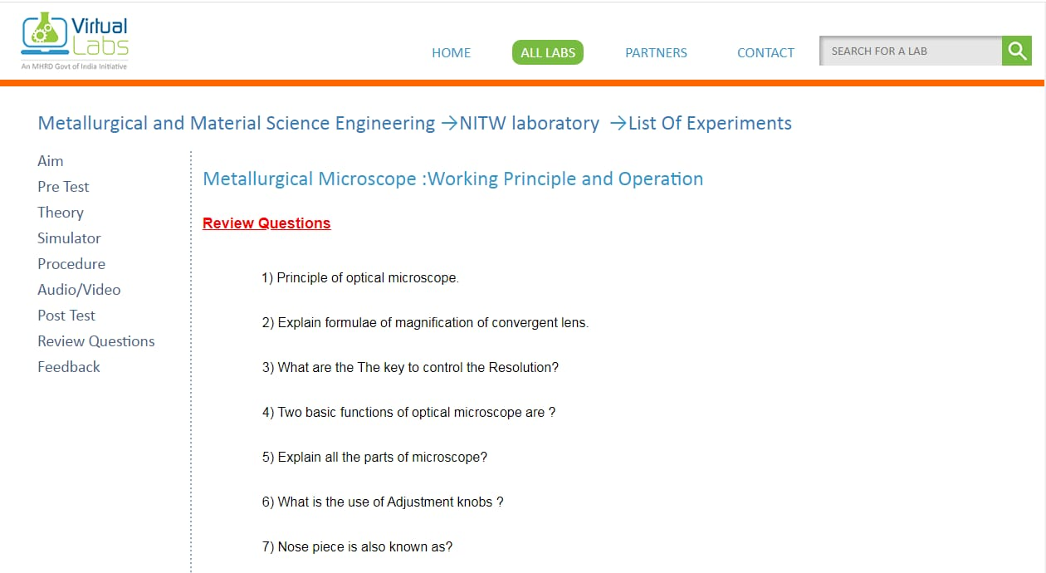
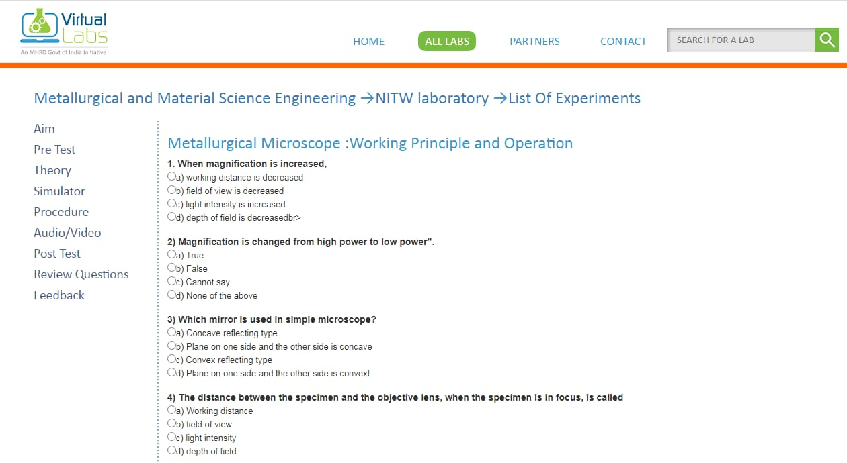

Slide 5
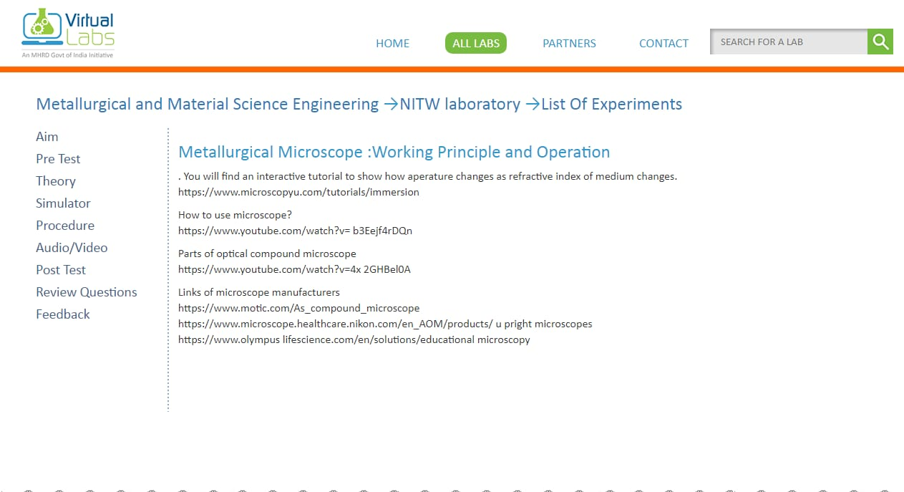

Slide 6
S.NO | roll numbers : | Names : | Contributed in :
1 | 195106 | Anurag | Developing the webpage , html and css work . All the technical part .
2 | 195110 | Balaji | Gathering team and and helping Anurag in technical part , checking the content part. Preparing this ppt :) ,
3 | 195117 | Neeraj Dattu | Content part – objective and theory part, conclusion.
4 | 195112 | Anusha | Prepared Questions for the pre test and post test
5 | 195109 | Hari Krishna | Gathering pics and relevant data.
6 | 195113 | Jayanth | Helping in theory part in procedure and aim
7 | 195115 | Jaswanth | Gathering of videos for reference.
8 | 195116 | Sandeep | Helped in gathering links along with jaswanth
9 | 195118 | Praveen | Helped to harikrishna

